Slide 1
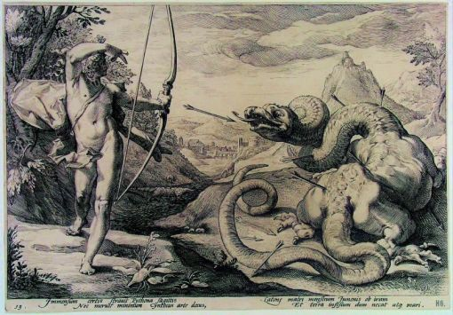
Python

Slide 2
Python, in Greek mythology, a huge serpent that was killed by the god Apollo at Delphi either because it would not let him found his oracle, being accustomed itself to giving oracles, or because it had persecuted Apollo's mother, Leto, during her pregnancy.
In the earliest account, the Homeric Hymn to Apollo, the serpent is nameless and female, but later it is male, as in Euripides' Iphigenia Among the Taurians, and named Python (found first in the account of the 4th-century-BC historian Ephorus; Pytho was the old name for Delphi).
Python was traditionally the child of Gaea (Earth) who had an oracle at Delphi before Apollo came. The Pythian Games held at Delphi were supposed to have been instituted by Apollo to celebrate his victory over Python.

